Slide 1

WELCOME BACK MINI-HACK CLOSING CEREMONY.
<p> Haji and Karrington</p>

Slide 2



THE MINI-HACK TRACKS
Sustainability
Food Access
Education
Develop innovative solutions using technology to promote sustainability and foster a greener future for all
Develop a creative, sustainable,and inclusive solution utilizing technology to enhance food access for vulnerable populations.
Use technology to create equitable, personalized, and motivated learning experiences for K-12 students.

Slide 3
OUR CORE CRITERIA
Business Value
Innovation
Does your idea provide a viable solution to a tangible problem? Can you extrapolate the solution?
Global Impact
How easy is it to implement your solution on a global scale?
How creative is your idea? Is it realistic?

Slide 4
INTRODUCING THE SUSTAINABILITY WINNERS
01
<p> Awarded to the team with best solution regarding sustainability issues.</p> <p> Prize: $250(Amazon Echo Dot, JBL Earbuds, Portable Charger, etc.)</p>

Slide 5
INTRODUCING THE FOOD ACCESS WINNERS
02
<p> Awarded to the team with best solution to enhancing food access for vulnerable populations.</p> <p> Prize: $250(Amazon Echo Dot,JBL Earbuds, Portable Charger, etc.)</p>

Slide 6
INTRODUCING THE EDUCATION
WINNERS
03
<p> Awarded to the team with best solution to education issues </p> <p> Prize: $250(Amazon Echo Dot,JBL Earbuds, Portable Charger, etc.)</p>

Slide 7

NOW, Introducing
OUR OVERALL WINNERS.
<p> Awarded to the team with the best all encompassing solution </p> <p> Prize: $500(Portable Monitor, JBL Speakers, Toshiba TV, etc.) </p>

Slide 8

JOIN US FOR COOKIE
O’ CLOCK
Stop by the Spark! Space every Wednesday at 3:00 p.m to take a break, play some games, and grab a cookie!

Slide 9
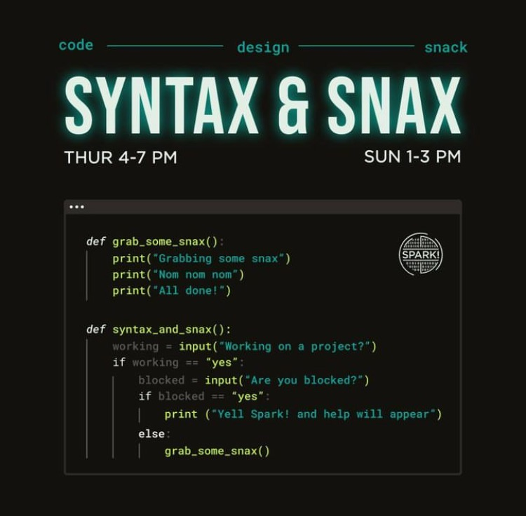
JOIN US FOR SYNTAX & SNAX
Work alongside your peers on personal projects with the help of Spark! Technical mentors and experts in residence! Your project, our support.

Slide 10
OUR IGNITE CLUBS
BUILDS| @bu_builds
Boston Hacks| @bostonhacks
Cybersecurity Assoc.| @bu_cybersecurity
Data Science Assoc.| @bu_dsa
Hack4Impact| @hack4impactbu
High Performance Computing| @bu_hpc
CleanTech Club| @bucleantech
FORGE Design Studios| @buforge
Girls Who Code| @gwcbostonu
Kappa Theta Pi| @ktpbostonu
Machine Intelligence Community| @bu.mic
PMReady| @bupmready
EthicAI| @bu_ethic_ai
National Society of Black Engineers| @bu_nsbe
Society of Asian Scientists and Engineers| @bu_sase
Society of Hispanic Professional Engineers| @shpe.bostonu
Society of Women Engineers| @bu_swe
Terrier Motorsport| @terrier.motorsport
Upsilon PI Epsilon| @upebu
Women in Association for Computing Machinery| @bu_acmw
Women in Computer Science| @buwics
HackHardware| @hackhardware_bu

Slide 11

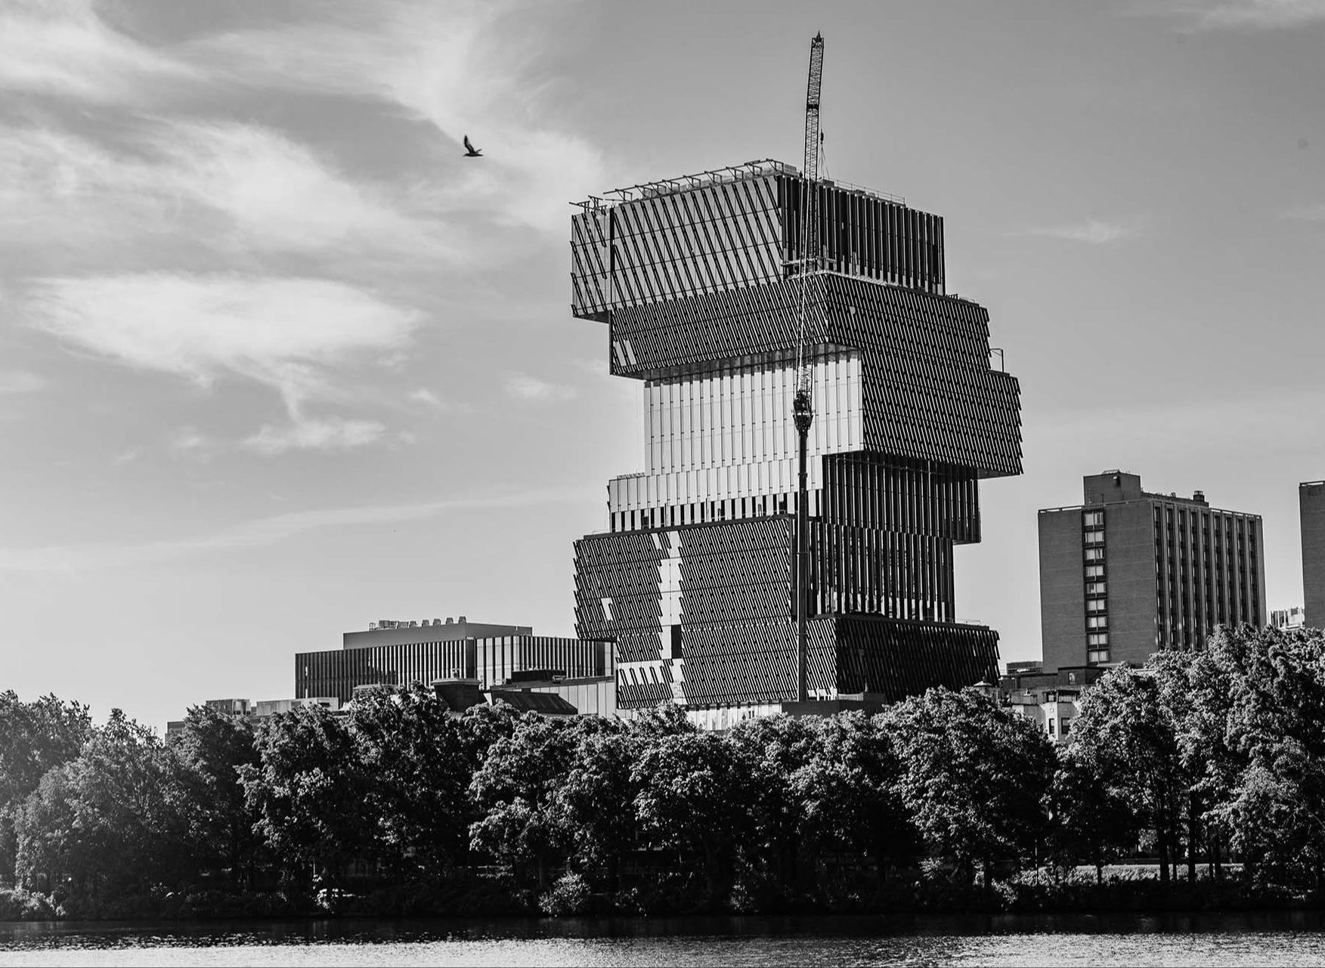
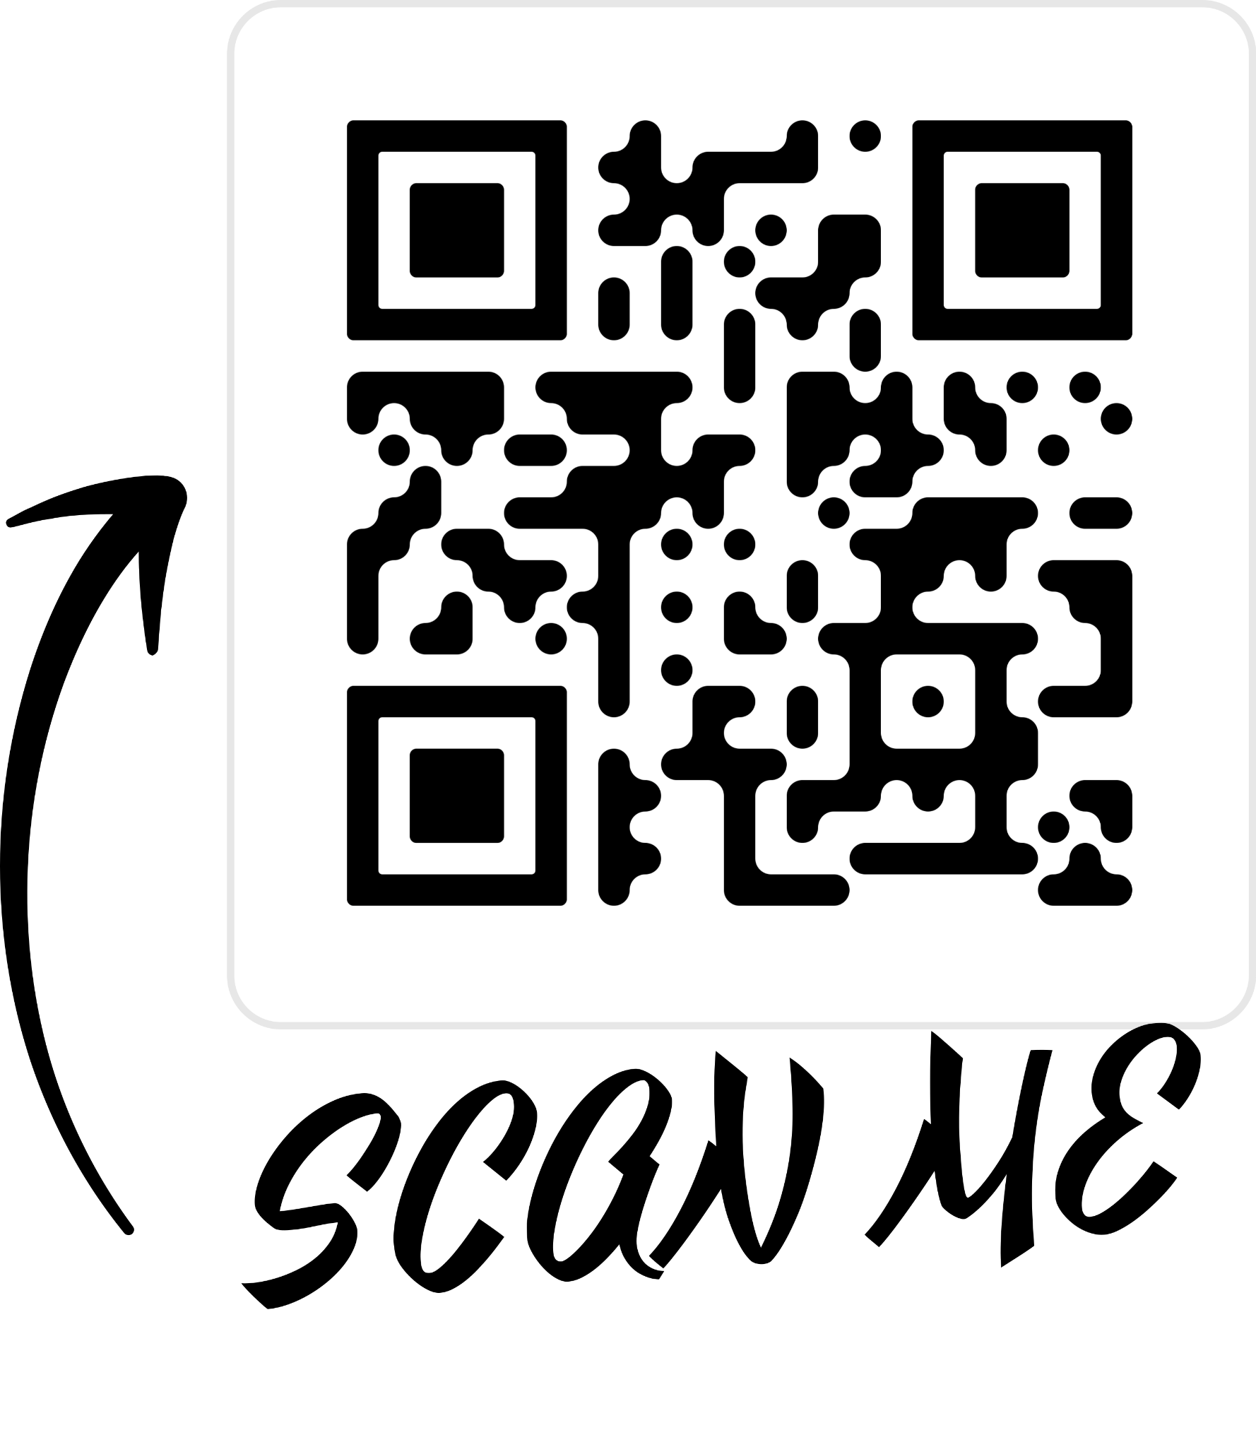
ANNUAL TFC CIVIC TECH HACKATHON SOON!
Scan this QR code to show interest and receive up to date information about the Civic Tech Hackathon

Slide 12



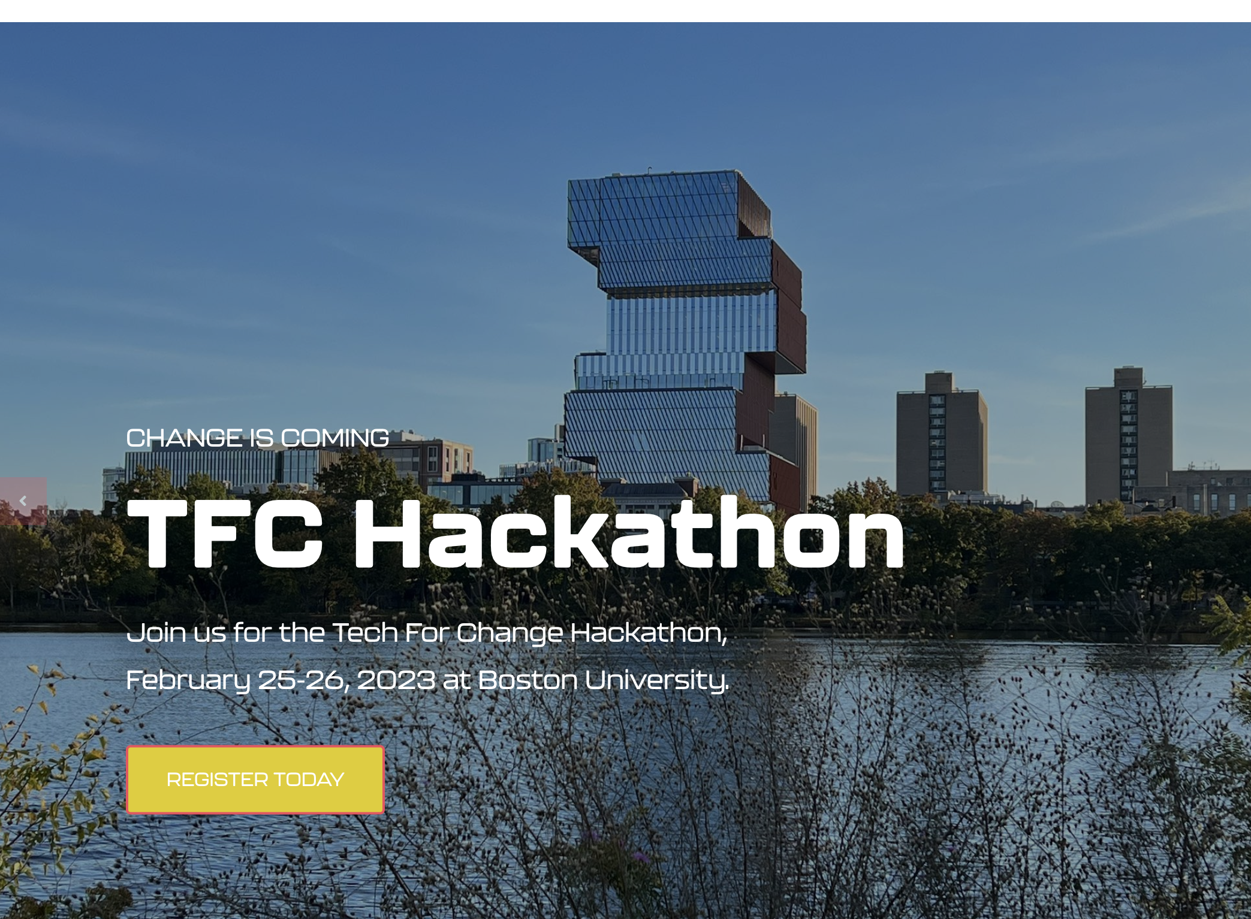

UPCOMING HACKATHONS
Fall:
Spark! Welcome Back MiniHack, Oct. 7
BostonHacks, Nov. 18-19 Hardware Hackathon, Oct. 21-23
Spring:
Spark! Civic Tech Hackathon, Feb 18-19
Spark! Art+CDS MiniHack, May 2
Forge Designathon
BUDSA Sustainability Datathon

Slide 13
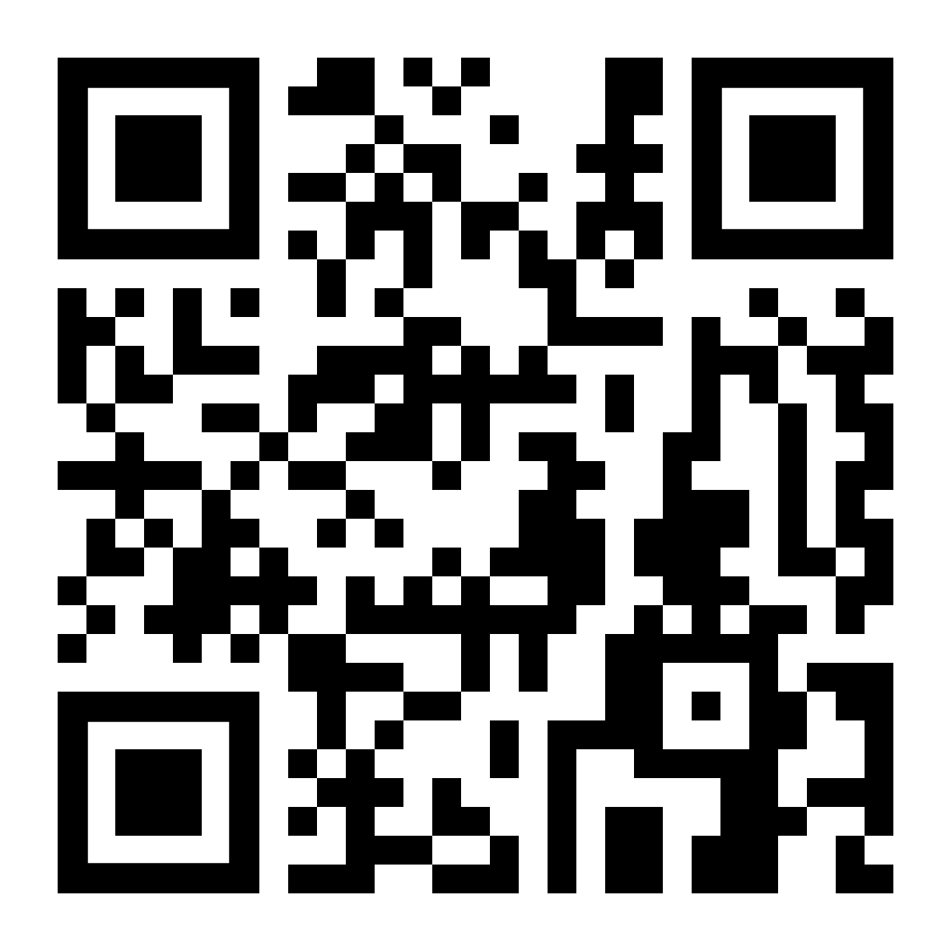
THANK YOU FOR ATTENDING!
Please fill out this feedback form so we can continue improving our hackathons every semester:

